Slide 1

FESTIVE SEASON & VEHICLE SALES
TRENDS AND PREDICTIONS FOR INDIA 2025
By Shreeya Gupta

Slide 2
INTRODUCTION
This investigatory project evaluates festive season vehicle sales trends in India using real-world data. The research aims to provide insightful recommendations for understanding consumer demand patterns and supporting strategic decision-making in the automotive industry.
Github Code - Link

Slide 3
METHODOLOGY
01
GATHERED VEHICLE SALES DATA FROM INTERNET SOURCES (INDUSTRY REPORTS, FADA DATASETS, NEWS ARTICLES).
DATA COLLECTION
02
CLEANED AND STRUCTURED THE RAW DATA → CONVERTED INTO EXCEL FORMAT FOR EASY HANDLING.
DATA PREPARATION
03
CLEANED AND STRUCTURED THE RAW DATA → CONVERTED INTO EXCEL FORMAT FOR EASY HANDLING.
DATA PROCESSING
04
APPLIED MATPLOTLIB AND SEABORN TO GENERATE CHARTS, IDENTIFY TRENDS, AND DERIVE INSIGHTS.
DATA VISUALIZATION

Slide 4
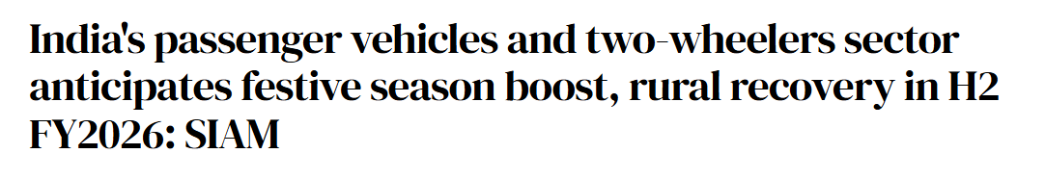
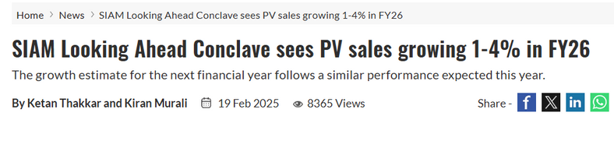
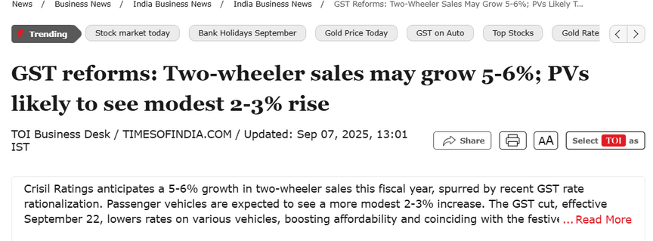
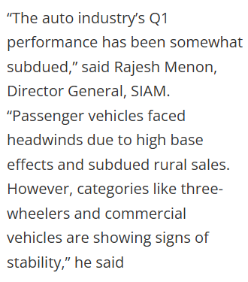
FESTIVE SEASON = HIGH-DEMAND PHASE
The Society of Indian Automobile Manufacturers (SIAM) states that the upcoming festive season typically serves as a key demand driver, especially with a supportive monsoon and reduced borrowing costs. The Tribune
Historically, new model launches, promotional offers, and cultural buying sentiment drive growth in both passenger vehicles (PV) and two-wheelers (2W).
At the SIAM Looking Ahead Conclave, PV sales growth for FY 2025-26 is projected at 1–4%, with multiple OEMs expressing cautious optimism.
FESTIVE SEASON OUTLOOK: VEHICLE SALES (CONTEXT & PREDICTIONS)

Slide 5



BACKGROUND OF THE STUDY
To ground this analysis, I looked at multiple trusted sources. FADA and SIAM provide the official retail and wholesale numbers. I also checked industry media like ET Auto and Business Standard for festive forecasts, and OEM press releases for new launches and offers.
What these sources highlight is that festive demand is driven by three key signals: strong promotional activity, consumer preference for buying during this season, and multiple new launches especially in EVs and compact SUVs. Additionally, a good monsoon is expected to support rural demand in two-wheelers and tractors.

Slide 6
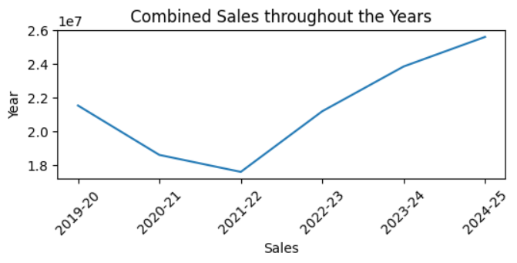
ANALYSIS
Combined Sales throughout the Years (2019–2025)
SALES DIPPED SHARPLY IN 2020–21 AND 2021–22, REFLECTING THE COVID-19 IMPACT AND SLOWER RECOVERY.
From 2022–23 onwards, there is a steady and strong rebound.
The trend suggests pent-up demand + structural recovery in the auto sector, setting up a positive festive season outlook for 2025.

Slide 7
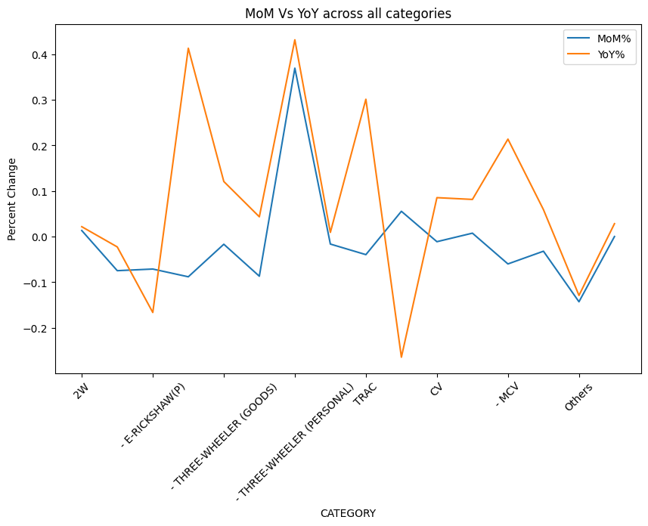
MoM% Insights (July → August 2025)
YoY% Insights (Aug 2024 → Aug 2025)

Slide 8
STRONG MONTH-ON-MONTH GROWTH:
WEAK MONTH-ON-MONTH PERFORMANCE:
STRONG ANNUAL GROWTH:
WEAK ANNUAL GROWTH:
Three-wheeler (Passenger, Goods, E-Rickshaw) show sharp positive jumps, suggesting rising demand in urban mobility and last-mile transport.
Tractors (TRAC) also post healthy MoM growth → driven by monsoon progress and rural sentiment.
(2W) and E-Rickshaw(P) dipped slightly, suggesting consumers might be waiting for festive promotions before making purchases.
Three-wheeler categories (especially passenger and personal) show YoY gains, reflecting rising urban demand for shared mobility and affordability.
MCVs (medium commercial vehicles) also see YoY growth, pointing to infrastructure and logistics expansion.
E-Rickshaw(P) and CVs are slightly negative YoY, suggesting challenges in higher-capacity electric adoption and heavy transport.

Slide 9
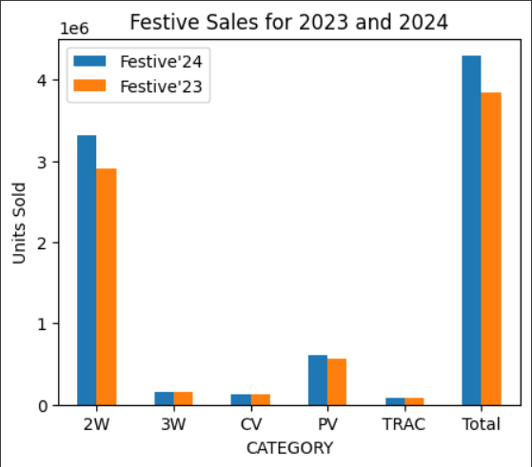
Insights
Two-Wheelers led in overall volume and saw a clear increase from the previous year.
Most categories recorded higher sales in 2024, except for Tractors.
Passenger and Commercial Vehicles maintained steady growth.
Total festive sales increased, reflecting overall market improvement.

Slide 10
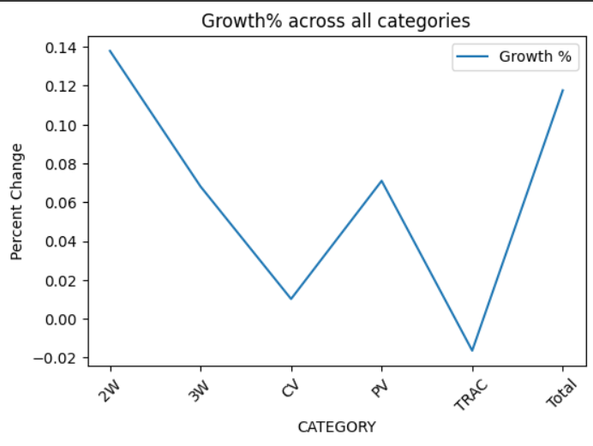
Insights
Two-Wheelers had the highest growth among all categories.
Tractors showed negative growth, indicating a decline in sales.
Commercial Vehicles and Three-Wheelers saw minimal positive growth.
Passenger Vehicles experienced moderate growth.
Overall category growth was strong and positive.

Slide 11
RECCOMENDATIONS TO CONSIDER
01
02
03
PRICE SENSITIVITY WITH TIMING
GROWING URBAN MOBILITY DEMAND
RURAL SENTIMENT BOOST
In the 2W and PV segments, consumers are demonstrating higher price consciousness. Many prefer to delay purchases until the festive period when they can take advantage of bundled discounts, low-interest financing, and exchange bonuses. This suggests that festive sales spikes are less about latent demand and more about strategic timing of purchases to maximize value.
The strong momentum in 3W passenger and goods categories indicates that affordability and shared transport remain central to urban consumer behaviour. Rising fuel prices and congestion have made cost-efficient last-mile solutions attractive, particularly for gig workers and small businesses. This reflects a shift in urban demand patterns from personal ownership to shared, utility-driven mobility.
Positive monsoon conditions and supportive government policies are expected to lift disposable incomes in rural India. This has a direct spillover effect on tractor and 2W demand, as these vehicles are essential for both livelihood and personal mobility in non-urban areas. With festive months aligning with harvest income, rural buyers are likely to demonstrate higher purchasing power and confidence this year.

Slide 12
THANK YOU
By Shreeya Gupta
sgofficial9999@gmail.com
Github Code - Link

